Slide 1
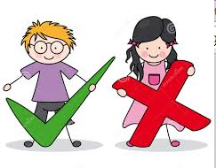
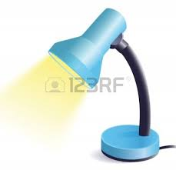
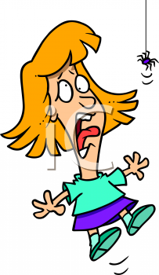
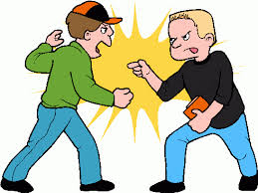
Tuesday 18th November 2014
Target: to identify and use the ‘igh’ sound
___ ___ ___ ___ ___
___ ___ ___ ___ ___
___ ___ ___ ___ ___ ___
___ ___ ___ ___ ___
___ ___ ___ ___ ___
s ___ ___ ___ ___

Slide 2
Tuesday 18th November 2014
Target: to identify and use the ‘igh’ sound
Now draw a picture of the following words
night
high
thigh
flight
sigh
bright

